Slide 1
Backup and Recovery Fundamentals
February 5, 2013
Ayman El-Ghazali
www.TheSQLPro.com
@TheSQLPro

Slide 2
Agenda
Recovery Models
Backup Types
Backup Options and Code
Restore Options and Code
Backup Strategy and Scenarios
RTO, RPO, and your CIO
Is this a DR or HA solution?

Slide 3
Recovery Models
Full - allows for point-in-time recovery for all transactions and requires T-Log maintenance
Simple - minimally logged operations
Bulk-Logged - Bulk operations are not logged, but others are, point-in-time recovery except for bulk load operations, requires T-Log maintenance
**Best practice is to run a T-log backup when switching between bulk load and Full recovery models**

Slide 4
Backup Types
Full - does a backup of all database pages and "marks" them as backed up
Differential - does a backup of all database pages that have changed since the last full backup
T-Log - does a backup of the transaction log; requires that at least one Full backup has been done before hand
FileGroup - does a backup of specific filegroups
File - backs up a specific database file

Slide 5
Backup Options
COMPRESSION
COPY_ONLY
DIFFERENTIAL
MIRROR TO
STATS = X (replace X with a number)
INIT | NOINIT (Overwrites Backups - Appends to backups)

Slide 6
Basic Backup Code
Backup Database [DatabaseName] TO [Disk/Device] = N'NameOrPath' WITH [OPTIONS]
-------------------------------
Backup Database DBTest1 TO Disk = N'C:\Backups\DBTest1_01012013.bak' WITH COMPRESSION, COPY_ONLY
--------------------------------
Backup Database DBTest1 TO Disk = N'C:\Backups\DBTest1_DIFF01012013.bak' WITH DIFFERENTIAL

Slide 7
Log Backup Code
Backup Log DBTest1
TO Disk = N'C:\Backups\DBTest1_Log01012013.trn'
----Demo----

Slide 8
Restores
The "Golden Rule" for restores?
TEST THEM!!!

Slide 9
Restore Options
WITH RECOVERY vs. NORECOVERY
VERIFY ONLY - verifies that the backup is ok
HEADERONLY - displays a list of backups on your backup file
FILELISTONLY - displays the list of database and log files on your backup file (Logical & Physical Name, Filegroup, and other great stuff)

Slide 10
Basic Restore Code
RESTORE DATABASE [DBName] FROM [Disk/Device] = N'NameOrPath'
----------------------------------------
RESTORE DATABASE DBTest1 FROM DISK = 'C:\Backups\DBTest1_01012013.bak' WITH RECOVERY
----------------------------------------
RESTORE DATABASE DBTest1 FROM DISK = 'C:\Backups\DBTest1_01012013.bak' WITH FILE = 1, NORECOVERY
RESTORE LOG DBTest1 FROM DISK = 'C:\Backups\DBTest1_Log01012013.trn' WITH FILE = 1, RECOVERY

Slide 11
Restoring Sequence
1. Take a backup of your Active/Tail Log
2. Restore your Full Backup (NoRecovery)
3. Restore your latest Diff (if available - NoRecovery)
4. Restore all your T-Logs (NoRecovery)
5. Restore your last T-Log the "Tail" (Recovery)
-----Demo-----

Slide 12
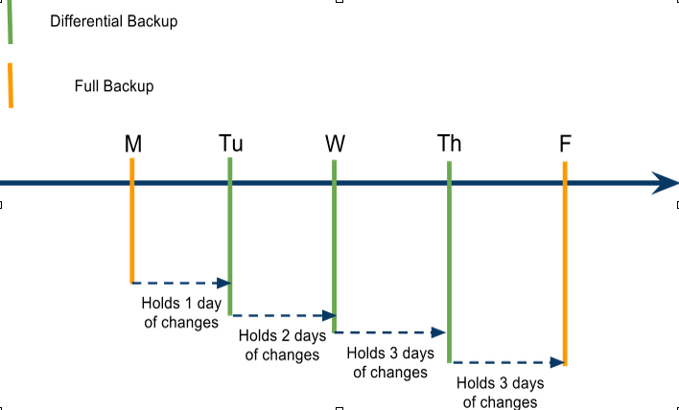
Backup Strategy and Scenarios

Slide 13
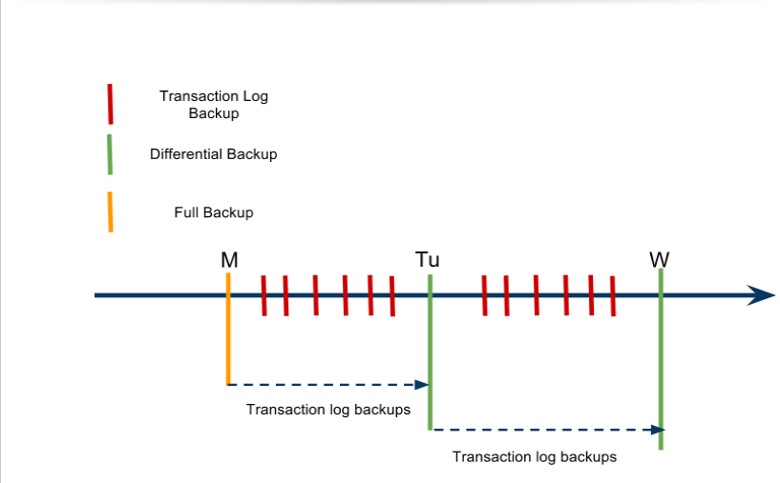

Slide 14
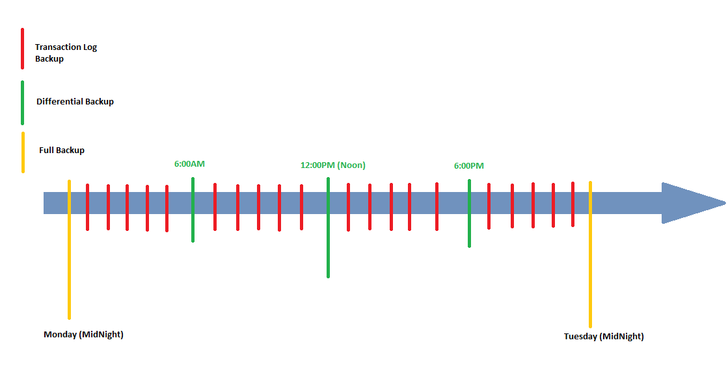

Slide 15
RTO, RPO, and your CIO
RTO - Recovery Time Objective
How long will it take you to recover after a disaster?
RPO - Recovery Point Objective
How much data are you willing to lose? Or How much can you recover? Or How often does your data change?
CIO - The person that will fire you if you fail on this!

Slide 16
DR vs HA
Disaster Recovery <> High Availability
For example:
Mirroring, Log Shipping vs. Backups
Availability Groups vs. Backups
Clustering vs. Backups

Slide 17

Special Thanks
Tim Radney for providing
me with a free copy of
this great book

Slide 18
Q&A
Slides and code can be found on my website
www.TheSQLPro.com
Under Presentations
Email: ayman@thesqlpro.com
LinkedIN: www.linkedin.com/in/aymansqldba
Twitter: @TheSQLPro

